Slide 1

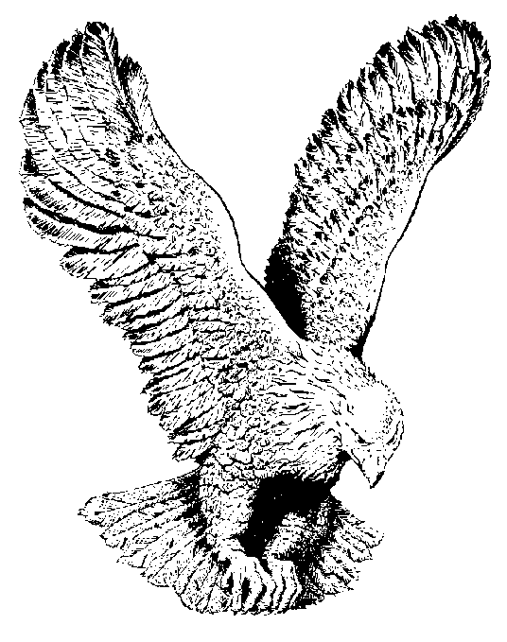
909 DAUGHTER OF ZION
Rejoice greatly O daughter of Zion
Shout O daughter of Jerusalem (repeat)
Behold thy King he cometh
Behold thy he cometh unto thee
Rejoice greatly O daughter of Zion
Shout O daughter of Jerusalem.

